Slide 1

Vel Tech Rangarajan Dr. Sagunthala R&D Institute of Science and Technology
School of Computing
Department of Computer Science and Engineering
10211CS224 / FULL STACK APPLICATION DEVELOPMENT (JAVA)
PROJECT REVIEW : MILESTONE PROJECT – 1
Date: 23-03-2026
Responsive E-Commerce Interface with State-Persistent Cart
SDG: SDG 9 –Industry, Innovation and Infrastructure
Presented By:
NEELAMPALLI VARUN– VTU24385– 23UECS0400
Courses Handling Faculty:
Dr. KAVIARASAN. S

Slide 2
INTRODUCTION
Background of the problem
Many websites are not mobile-friendly and lose cart data after refresh.
Users expect smooth shopping experience like Amazon and Flipkart.
Why this project is important
It improves user experience by making the website responsive and reliable. It also helps us learn real-world web development concepts.
Real-world relevance
Modern shopping websites like Myntra use responsive design and persistent carts. This project works similar to real e-commerce platforms.
Brief overview of the system
Users can view products, add items to cart, and update quantity easily. The cart data is saved using Local Storage even after page refresh.
1
2
3
4
5
6
7
8
9

Slide 3
PROBLEM STATEMENT
1
2
Many basic e-commerce websites are not responsive and do not work properly on mobile or tablet devices. The layout may break on different screen sizes, which affects user experience. In some websites, cart items disappear after refreshing the page or closing the browser. This happens because there is no proper system to save cart data. As a result, users lose their selected products and feel frustrated. Modern platforms like Amazon provide responsive design and maintain cart data even after refresh. Therefore, there is a need to develop a responsive e-commerce interface with a state-persistent cart system to improve usability and reliability.
3
4
5
6
7
8
9

Slide 4
OBJECTIVE(S)
To design and develop a responsive e-commerce interface that works smoothly on mobile, tablet, and desktop devices.
To implement a responsive e-commerce interface that adapts to different screen sizes and devices.
To improve the responsiveness of the e-commerce interface so it works smoothly on all devices.
To evaluate the efficiency and reliability of the state-persistent cart system during user interactions.
1
2
3
4
5
6
7
8
9

Slide 5
PROPOSED SYSTEM
1
Description of the solution
-The solution is a responsive e-commerce web applicartion with a state-persistent cart system.
-It is designed to adapt automatically to different screen sizes such as mobile, tablet, and desktop.
How it solves existing issues
-It uses responsive design to fix layout problems on mobile and tablet devices.
-It ensures proper displays across different screen sizes.
Advantages over current systems
-Provides a fully responsive design that works on all devices.
-Maintains cart data even after page refresh or browser closure.
2
3
4
5
6
7
8
9

Slide 6
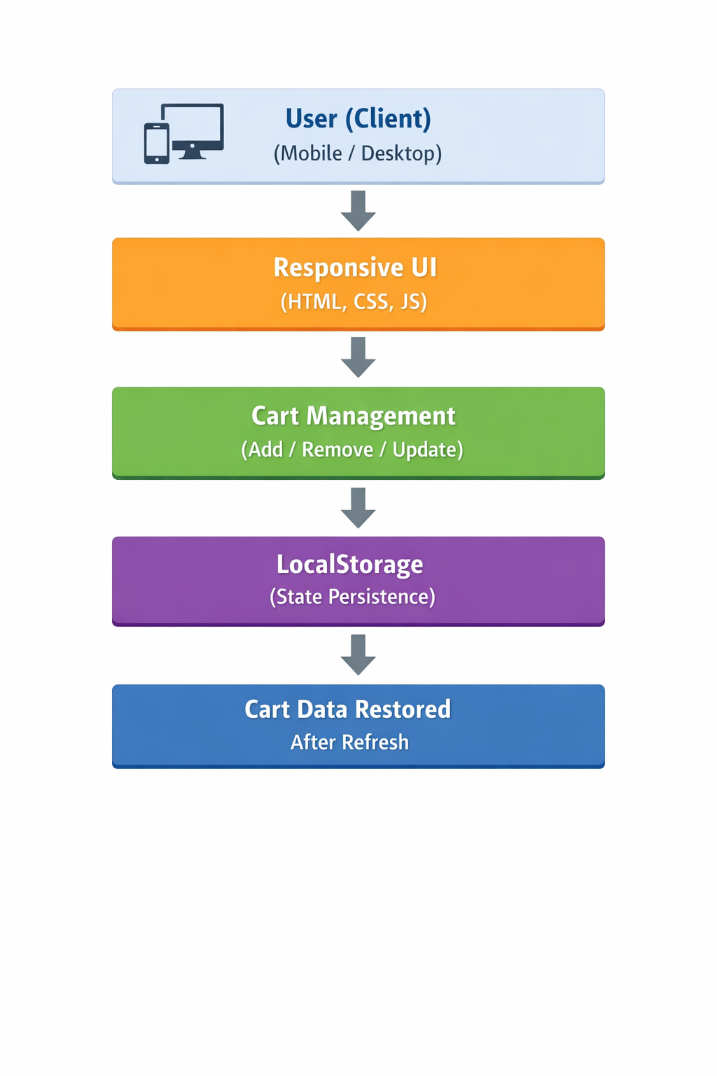
PROPOSED SYSTEM ARCHITECTURE
Input
The input is the user actions such as selecting products, adding items to the cart, removing items, and updating quantity.
These actions are given through buttons and forms in the web interface.
Processing
The system processes user actions using JavaScript logic.
It calculates total price, updates cart items, and manages cart operations dynamically.
Database
Instead of a traditional database, the system uses Local Storage in the browser.
It stores cart data temporarily to maintain state persistence even after refresh.
Output
The output is the updated cart display shown on the screen.
It includes product details, quantity, total price, and restored cart data after reload.
1
2
3
4
5
6
7
8
9

Slide 7
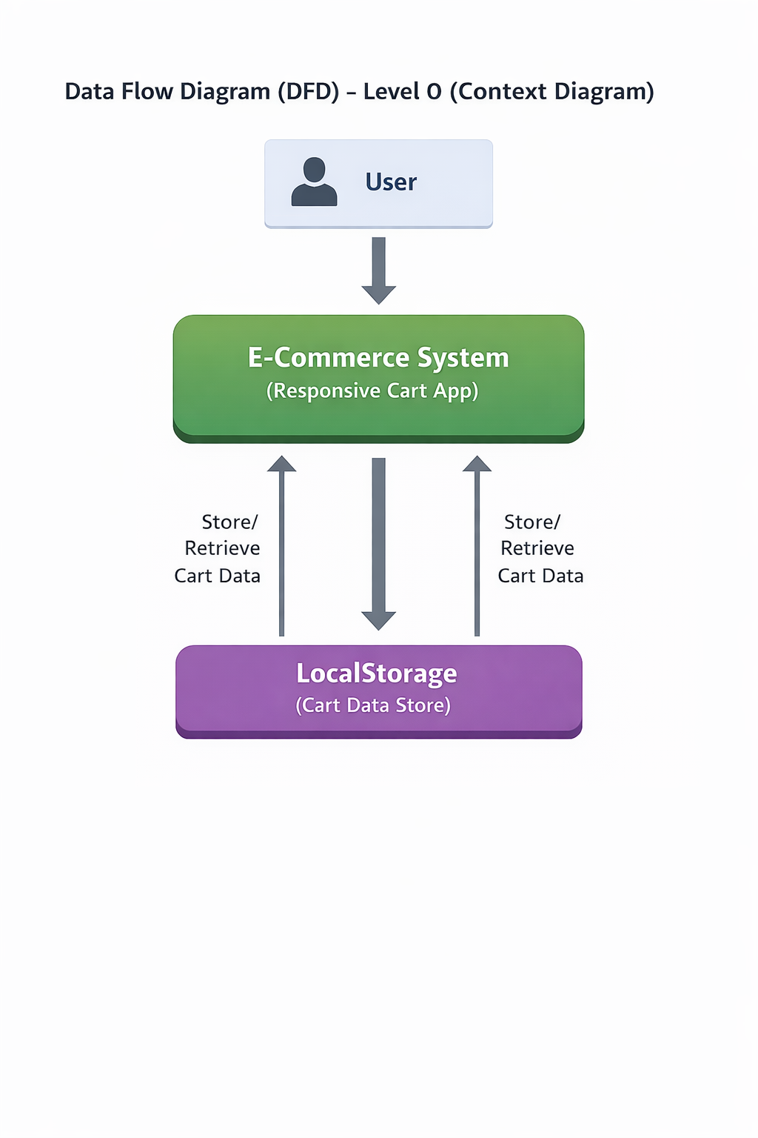
WORKFLOW
1
2
3
4
5
6
7
8
9

Slide 8
TECHNOLOGIES USED
1
🔹 Frontend:
HTML, CSS, Bootstrap, and JavaScript are used to design the responsive user interface.
🔹 Backend:
JavaScript is used to handle cart operations like add, remove, update, and price calculation.
🔹 Database:
Local Storage is used to store cart data and maintain state persistence.
🔹 Tools:
VS Code for development and Google Chrome for testing and debugging.
🔹 Hardware / Software Requirements:
Hardware: Minimum 4GB RAM, i3 Processor or above, Basic Computer System.
Software: Windows/Linux OS, Web Browser (Chrome/Edge), Code Editor (VS Code).
2
3
4
5
6
7
8
9

Slide 9
MODULE DESCRIPTION
Module 1: User Interface
This module displays products and provides buttons for add to cart, remove, and update quantity. It ensures the website is responsive on mobile, tablet, and desktop devices.
Module 2: Product display
This module shows product details like name, price, and image. It organizes products in a clean and structured layout.
Module 3: Cart Management
This module handles add, remove, and update cart operations. It also calculates the total price dynamically.
Module 4: State persistence
This module stores cart data using LocalStorage. It restores cart items automatically after page refresh or browser restart.
Module 5:Data Handling
This module manages data flow between the interface and storage. It ensures proper updating and retrieval of cart information.
1
2
3
4
5
6
7
8
9

Slide 10
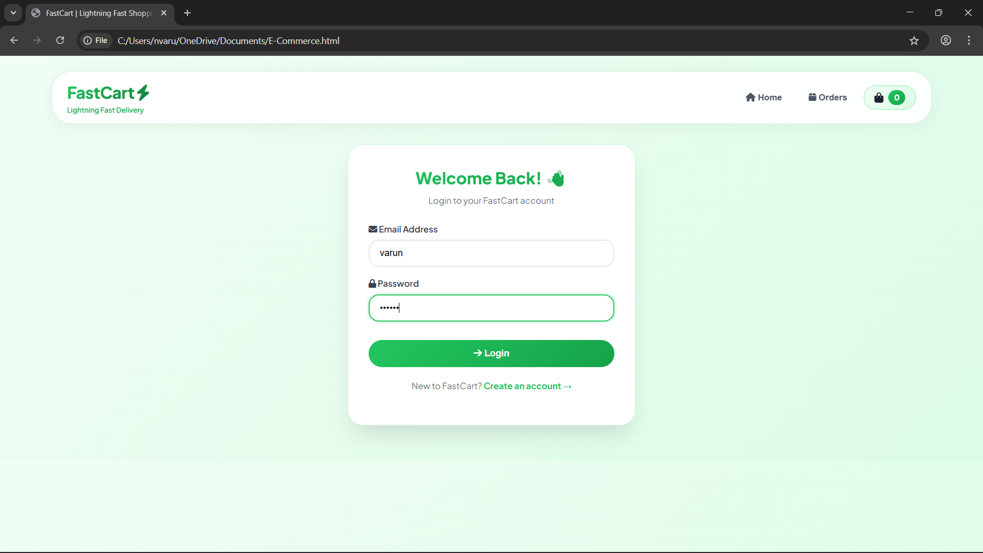
IMPLEMENTATION SCREENSHOTS
1
2
3
4
5
6
7
8(A)
9

Slide 11
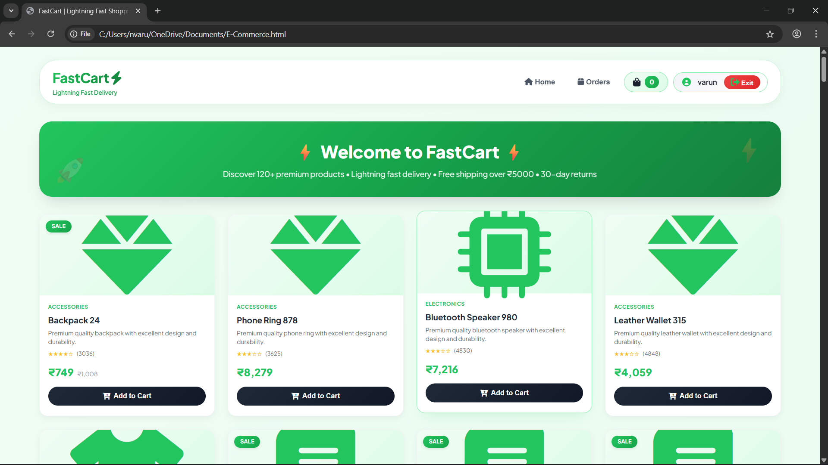
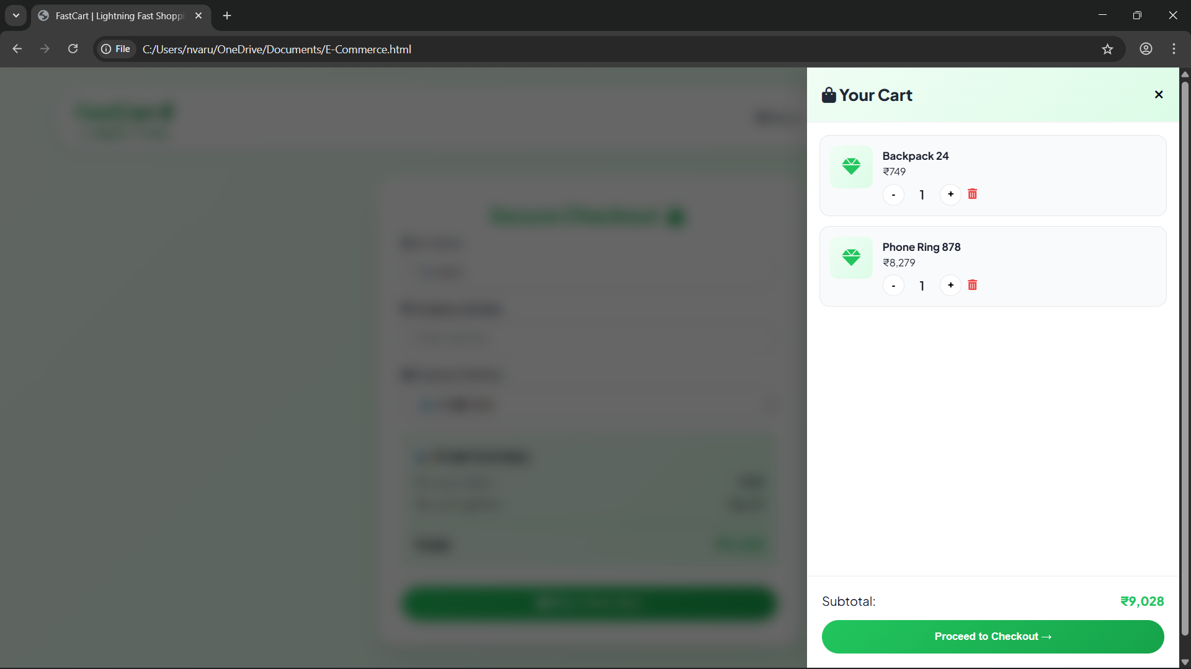
IMPLEMENTATION SCREENSHOTS
1
2
3
4
5
6
7
8(B)
9

Slide 12
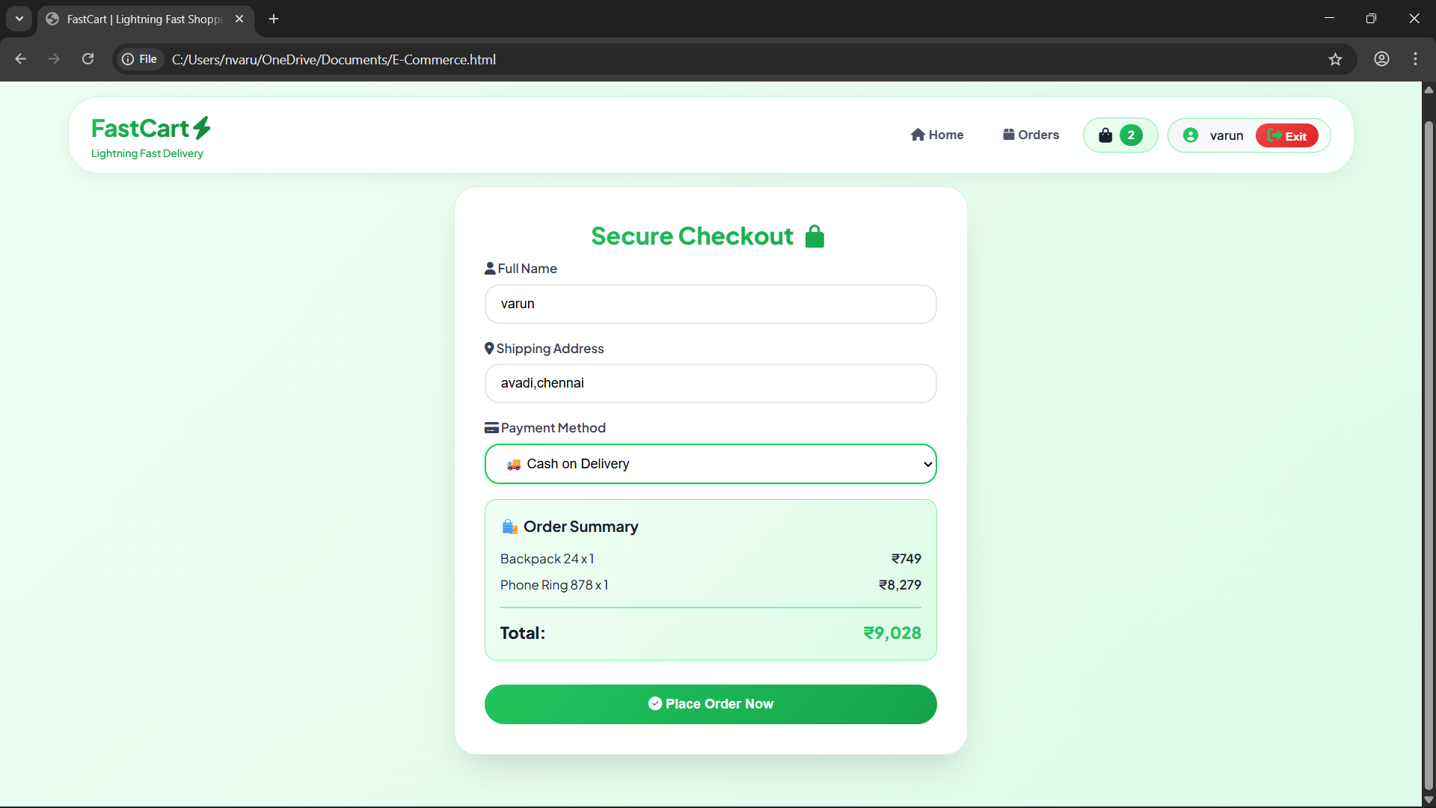
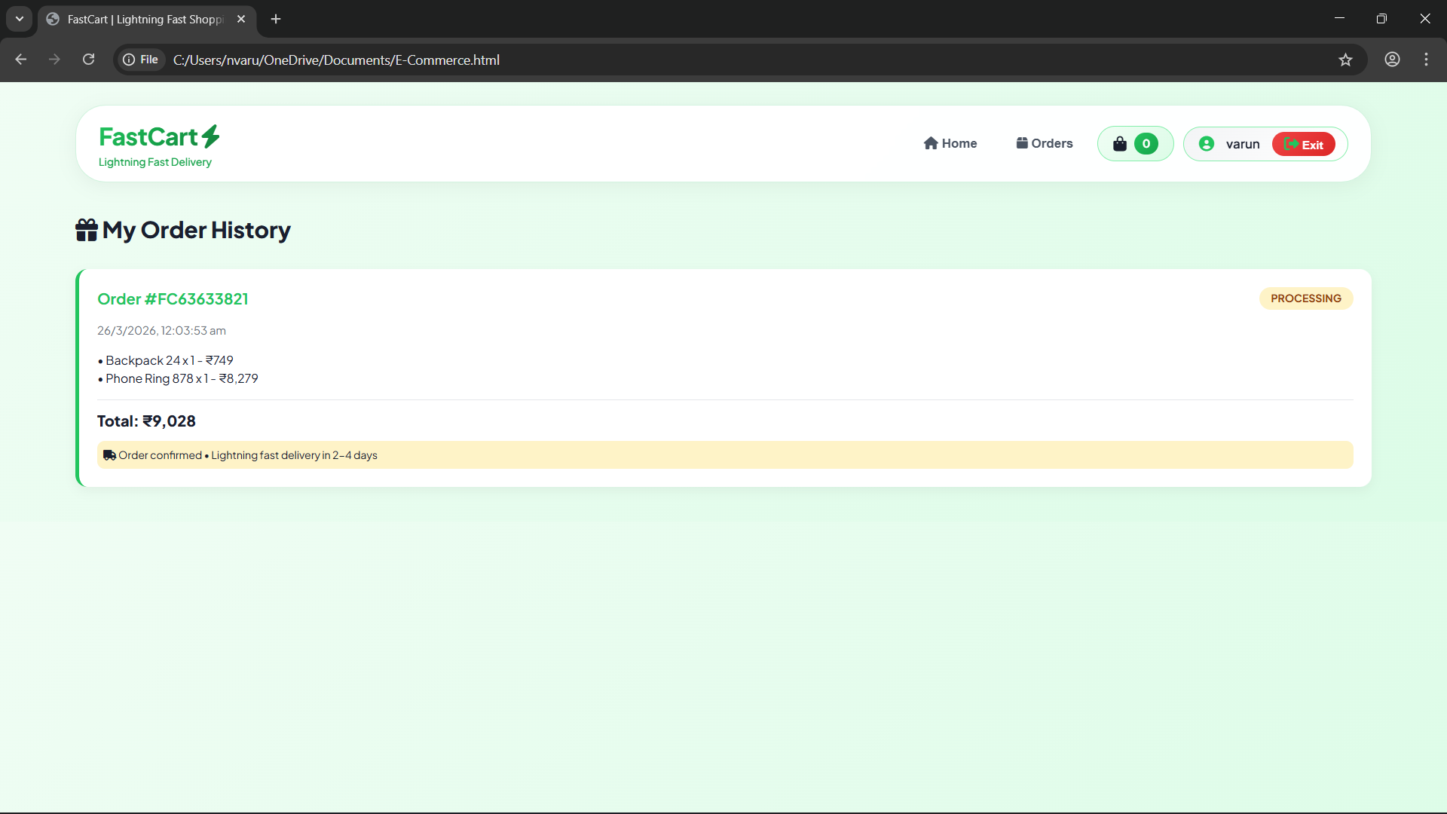
IMPLEMENTATION SCREENSHOTS
1
2
3
4
5
6
7
8(C)
9

Slide 13
ADVANTAGES & LIMITATIONS
1
Advantages
1.Responsive design works on mobile , tablet, and desktop devices.
2.Simple and cost-effective implementation.
3.Fast performance since data is stored in the browser.
4.Easy to develop and does not a require a complex backend.
Limitations
1.Uses local storage,so data is stored only on one Device/Browser.
2.No real backend database for large-scale applications.
3.Not suitable for multi-user or large-scale applications.
4.Limited security compared to server-side storage.
2
3
4
5
6
7
8
9

Slide 14
Thank you

